Slide 1
Pathway Approach to Detecting Glioblastoma
Bernardo Jordan
IDC 6940

Slide 2
Overview
Background on Brain Cancer and Glioblastoma
Goals and Methodology
Results
Discussion
Conclusion

Slide 3
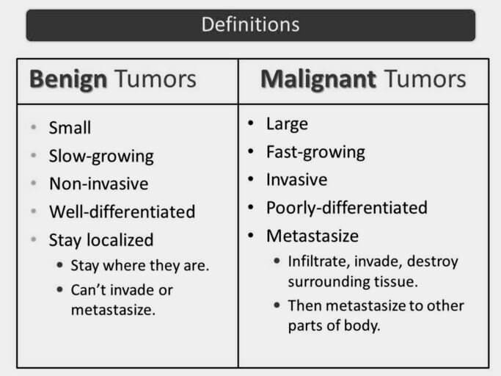
Brain Cancer
~700,000 Americans living with a brain tumor.^{[1][2]}
69.8% Benign
30.2% Malignant
~1.4% of all new cancer cases are primary malignant brain tumor.
Estimated that 87,000 people will be diagnosed with a brain tumor in 2020.
Glioblastoma accounts for 45% of all malignant brain tumors and is the deadliest type of brain tumor.
Figure 1: Benign vs Malignant Tumors
Source: https://diffzi.com/benign-tumor-vs-malignant-tumor/

Slide 4
Causes of Brain Tumors
The exact cause of primary brain tumors is unknown.^{[3]}
Risk Factors:
Age
The risk of developing a brain tumor increases with age.
The most common age range is 45 to 65 years old.
However some brain tumors are more common in children and young adults.
Exposure to radiation
Being exposed to ionizing radiation increases your risk of developing a brain tumor.
Examples: Radiation therapy and X-Rays.
Family History
Having a family history of brain tumors doubles your risk of developing a brain tumor.

Slide 5
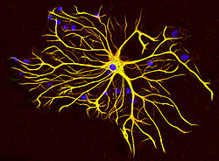
Glioblastoma
Aggressive type of cancer with very poor survival rate.
Glioblastoma occurs in the brain and spinal cord.
Forms from star shaped cells called Astrocytes.
Different grades (I – IV).
I being the least deadly.
IV being the deadliest.
Figure 2: Astrocyte
Source: https://en.wikipedia.org/wiki/Astrocyte

Slide 6
Glioblastoma Survival Outlook
Glioblastoma is one of the most complex, and treatment resistant cancers.^{[4][5]}
Median Survival Time is only nine months.
Rises to 15-16 months with treatment.
Only 5% of patients survive past 5 years.
Despite considerable advancements in the median and short-term survival rate, very little progress has been made in raising the rate of survival past 5 years.
Many doctors and researchers are looking for more aggressive types of treatments to increase the survival rate past 5 years.

Slide 7
Treatments for Glioblastoma
Common treatments for Glioblastoma are surgery, radiation, and chemotherapy.
Surgery^{[6]}
Make small incision into the skull and attempt to remove as much of the tumor as possible.
Very difficult since tumor has tentacles that are not centrally located.
Many risks involved. Infection, bleeding, and location of the tumor can cause damage to the brain.
Figure 2: Astrocyte
Source: https://en.wikipedia.org/wiki/Astrocyte

Slide 8
Treatments for Glioblastoma
Radiation Therapy^{[7]}
High energy beams, such as X-rays, are fired at the cancer cells.
Side effects include nausea, vomiting, and headaches. If the tumor is large enough, then memory loss, personality changes, and trouble concentrating can occur.
One risks involved with Radiation Therapy is that another tumor may form as a result.
Chemotherapy^{[8]}
Use of drugs to kill the cancer. Most common drug used is temozolomide (Temodar).
Sides effects include nausea, vomiting, hair loss, headaches, weakness, etc.
Long term side effects include damage to other organs and risk of developing a second cancer.

Slide 9
Glioblastoma Diagnosis
Neurological Exam^{[6]}
Doctor checks vision, hearing, balance, coordination, strength, and reflexes.
Imaging Test
MRI, CT scan, and PET scan.
Test for other types of cancer in your body
It is possible that the brain tumor found did not originate in the brain.
It may have metastasized from somewhere else in the body.
Perform a biopsy
Sample of the abnormal tissue is collected.
Sample is analyzed under a microscope to determine if the sample is cancerous or benign.

Slide 10
Detecting Glioblastoma
While these tests to diagnosis glioblastoma work, they aren’t very efficient.
MRI and other imaging scans sometimes have trouble accurately visualizing the tumor.
Time delay from original diagnosis to conformation can allow the tumor to grow and metastasize.
Median Survival Time: 9 Months
In addition, these tests and procedures can be expensive and invasive
As a result, a lot of research is being done in the field of detecting glioblastoma early in a low cost, non-invasive way.^{[28]}
The earlier the treatment, the better the survival outcome due to better guided treatment.

Slide 11
Goals
Develop an efficient process to detect Low Grade Glioblastoma.
Look at causal relationships between Glioblastoma and Genetic Pathways.
See what pathways are relevant to Glioblastoma.
Look at the genetic connections of Glioblastoma.

Slide 12
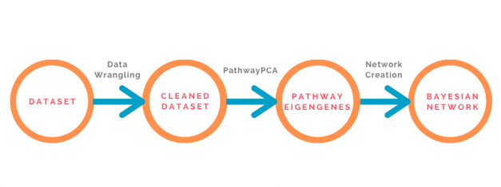
Methodology Overview

Slide 13
Rembrandt Dataset
Repository for Molecular Brain Neoplasia Data^{[9]}
Joint initiative between National Cancer Institute (NCI) and National Institute of Neurological Disorders and Strokes (NINDS).
Collected brain cancer data from 14 universities/institutes and merge the data into one large dataset.
To provide a large and robust dataset for researchers to use since brain cancer data is limited.
Used only the low-grade glioblastoma data from the Dataset.

Slide 14
Data Wrangling
The Affymetrix Gene Key was downloaded
The Rembrandt dataset is not label directly with genes, instead they are labeled with a proprietary ID system from Affymetrix.
Replaced all the Affymetrix IDs with the correct HUGO Gene Symbol.^{[29]}
The extraneous unlabeled Affymetrix IDs were removed
The Affymetrix HG-U133 Plus 2 Gene chip contains binding sites that are not specific.
Hypothetical protein/genes and irrelevant protein.
The data was centered and scaled
Many of the genes have different expression levels, it is important to scale everything down.
Once the final dataset was obtained, 20% was set aside as a test set.

Slide 15
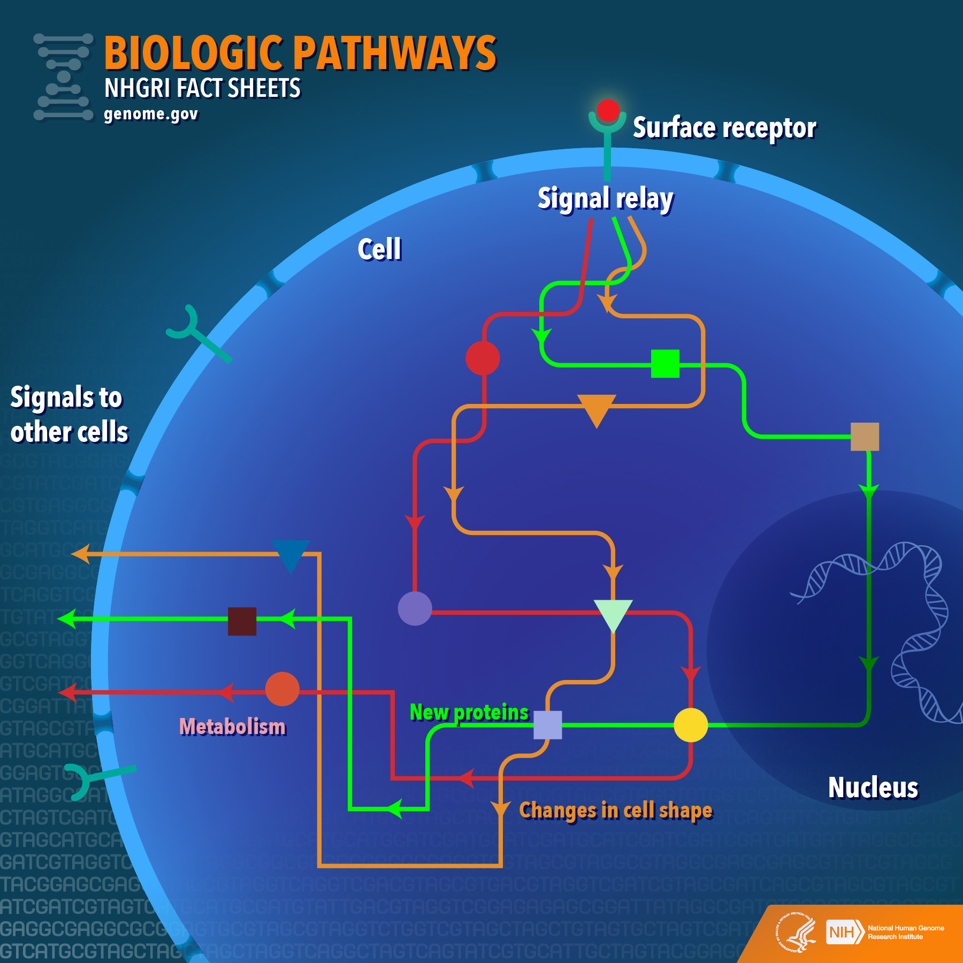
Biological Pathways
A biological pathway is a series of actions by molecules in a cell that lead to a change in the cell or a product.^{[10]}
In layman's terms, a chain reaction in the cell caused by some stimuli.
Metabolic Pathways
Signal Transduction
Gene-Expression
Figure 3: Biological Pathway Example
Source: https://www.genome.gov/about-genomics/fact-sheets/Biological-Pathways-Fact-Sheet

Slide 16
Pathway PCA
Allows for principal component analysis using pathway-based analysis approach.^{[11]}
Methodology
Download collection of biological pathways from a database.
C2 Canonical Pathways – canonical representations of biological processes complied by experts.^{[30]}
Performs principal component analysis of the relevant genes for biological pathway (unsupervised).
Extract Eigengenes.
Finds biological pathways that are biologically relevant to the clinical response (supervised).
Creates a final dataset.

Slide 17
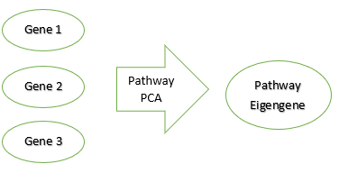
Pathway PCA
Download collection of biological pathways from a database.
C2 Canonical Pathways – canonical representations of biological processes complied by experts.
This includes a large variety of pathways. From metabolic pathways to cancer specific pathways.
Performs Principal Component Analysis of the relevant genes for biological pathway (unsupervised).
Each pathway is comprised of a set of genes.
Principal Component Analysis is performed for each pathway.

Slide 18
Pathway PCA cont.
Extract Eigengenes.
The Eigengenes from the PCA are extracted.
Finds biological pathways that are biologically relevant to the clinical response (supervised).
The Eigengenes that were extracted are then tested for biological relevance against the clinical response.
The Eigengenes for pathways that are very relevant to the clinical response variable have a low p values while Eigengenes for pathways that are not very relevant have high p values.
Creates a final dataset.
The relevant Eigengenes are then used to create a final dataset.

Slide 19
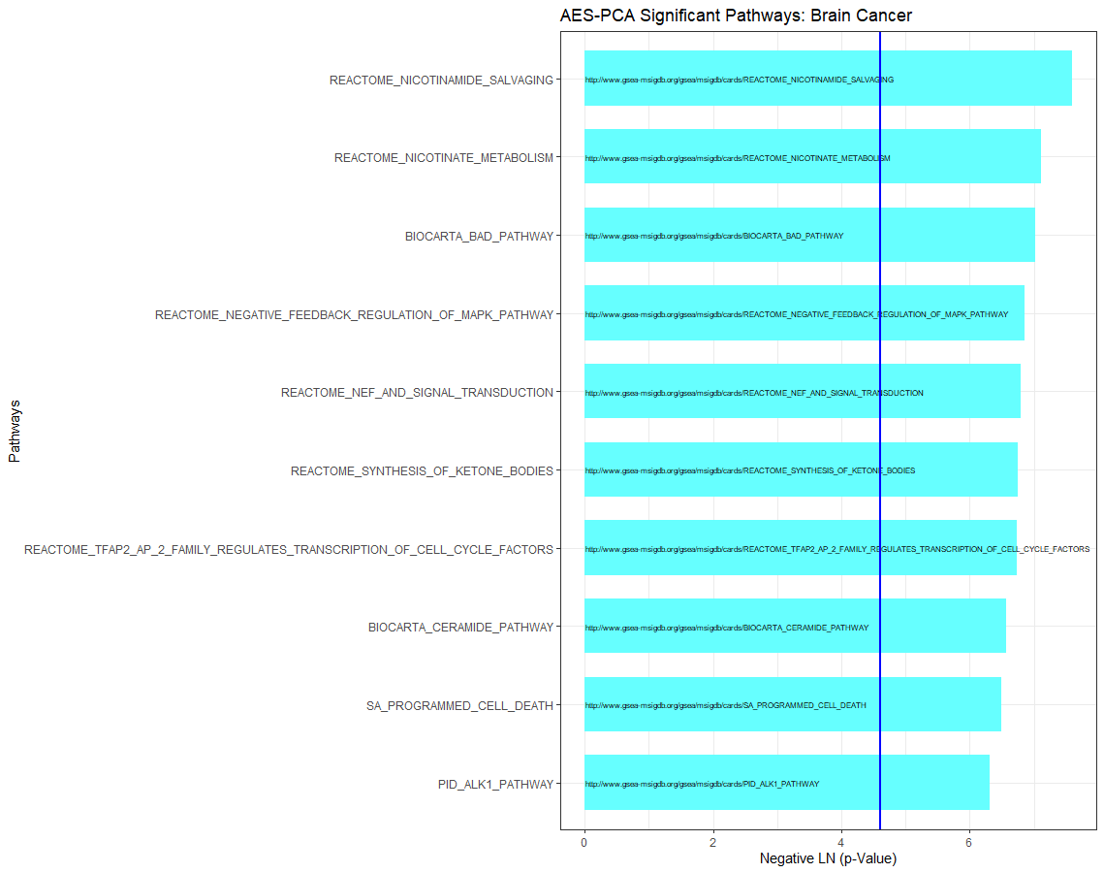

Slide 20
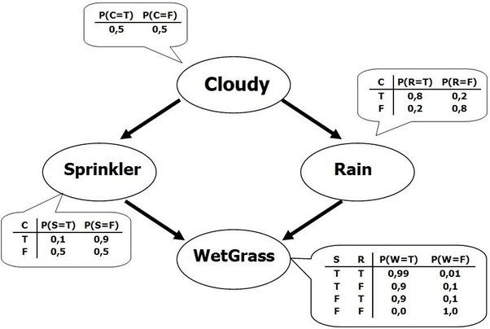
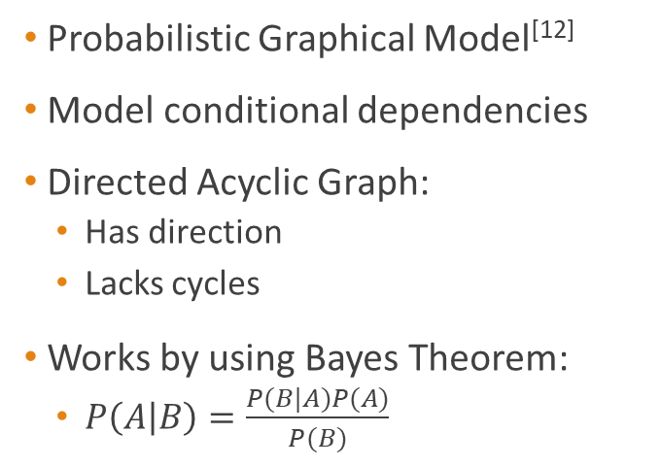
Bayesian Network
Probabilistic Graphical Model^{[12]}
Model conditional dependencies
Directed Acyclic Graph:
Has direction
Lacks cycles
Works by using Bayes Theorem:
$P\left(A | B\right)=\frac{P(B|A)P(A)}{P(B)}$
Figure 4: Bayesian Network Example
Source: https://towardsdatascience.com/introduction-to-bayesian-networks-81031eeed94e

Slide 21
Bayesian Network Creation
To create the Bayesian Network, the BNLearn package was used.
BNLearn is a very expansive package that contains many useful tools to create and test Bayesian networks.^{[13]}
From the available Bayesian Network Algorithms, the Hill Climbing Algorithm was used.
Hill Climbing Algorithm is a Score-Based Algorithm.
Tries to find the most optimal Bayesian Network by performing every possible edge addition, reversal or removal and selecting the one that increases the overall score of the network.
It does this over and over until the overall score of the network cannot be increased.

Slide 22
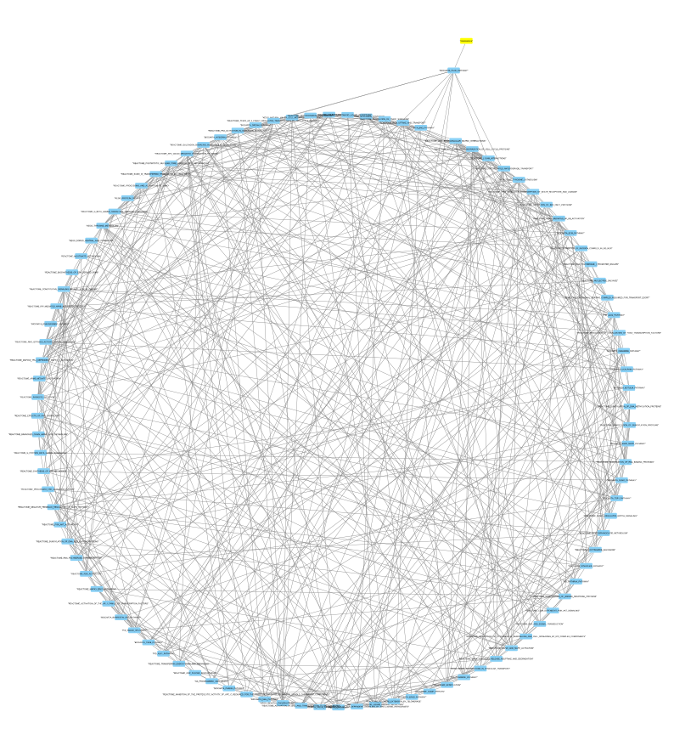
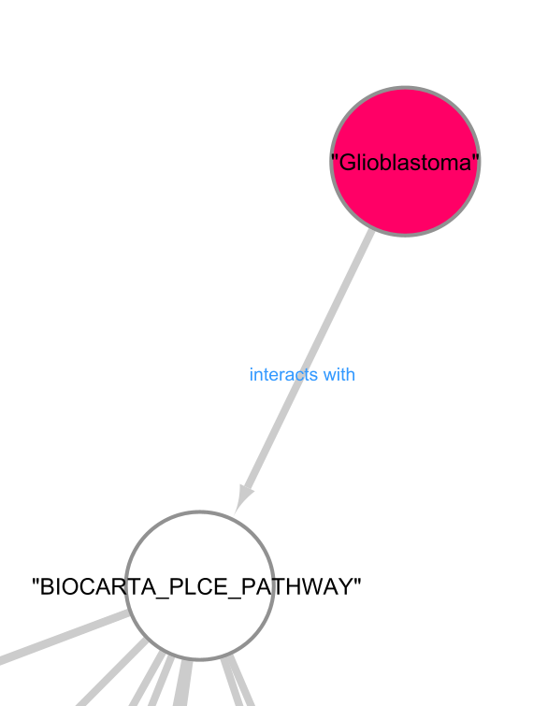
Bayesian Network

Slide 23
Evaluating the Network
Predicted Glioblastoma and measured the prediction error.
Performed K-fold validations to test performance of the Bayesian Network.
Compared the Bayesian Network to other common classification algorithms.^{[15]}
Naïve Bayes
K Nearest Neighbor
Random Forest
Support Vector Machine
Artificial Neural Network
Compared the Pathway Approach vs Network Created from solely the top 100 correlated genes.

Slide 24
10-Fold Validation Results
Pathway Bayesian Network compared to other algorithms
 | Average Accuracy | Standard Deviation
Hill Climbing Bayesian Network | 78% | 3.6%
Classical Naïve Bayes | 73% | 8.4%
K-Nearest Neighbor | 78% | 3.6%
Support Vector Machine | 78% | 3.6%
Random Forest | 78% | 5.9%
Artificial Neural Network | 68% | 7.1%

Slide 25
10-Fold Validation Results
Pathway Approach vs Gene based Approach
Algorithms | Average Accuracy (Pathway) | Standard Deviation (Pathway) | Average Accuracy (Gene) | Standard Deviation (Gene)
Hill Climbing Bayesian Network | 78% | 3.6% | 73% | 3.7%
Classical Naïve Bayes | 73% | 8.4% | 74% | 12.8%
K-Nearest Neighbor | 78% | 3.6% | 76% | 7.1%
Support Vector Machine | 78% | 3.6% | 74% | 8.0%
Random Forrest | 78% | 5.9% | 75% | 8.5%
Artificial Neural Network | 68% | 7.1% | 74% | 11.2%

Slide 26
Final Testing Results
Algorithms | Accuracy (Pathway)
Hill Climbing Bayesian Network | 80%
Classical Naïve Bayes | 82%
K-Nearest Neighbor | 80%
Support Vector Machine | 78%
Random Forest | 78%
Artificial Neural Network | 68%

Slide 27
Discussion
Glioblastoma affects the entire body.
It is important to look at the biological relevance of the network.
Interpret the network:
Looking at how often each Pathway appears in each K-Fold Networks.
Explore the Pathway by looking at which genes are upregulated and downregulated.
Compare to the literature for accuracy.

Slide 28
Repeating Pathways
Pathway | Percentage | Association with Glioblastoma
Prion Pathway | 100% | Prions contribute to the tumorigenesis of Glioblastoma. (Ryskalin, L., 2019)
Cell Programmed Death | 100% | Deregulation of this pathway allows for Glioblastoma cells to grow unchecked. (Fulda, S., 2018)
MAPK Pathway | 100% | Hyperactivation of this pathway allows for tumorigenic progressions. (Krishna, K., 2020)
PLC-epsilon pathway* | 80% | Deregulation promotes Tumorigenesis and is a known to contain oncogenes for many types of cancer. (Tyutyunnykova, A., 2017)

Slide 29
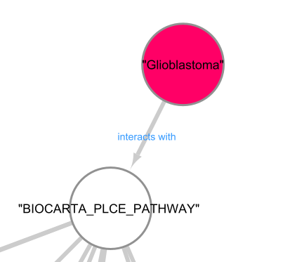
Exploring Network

Slide 30
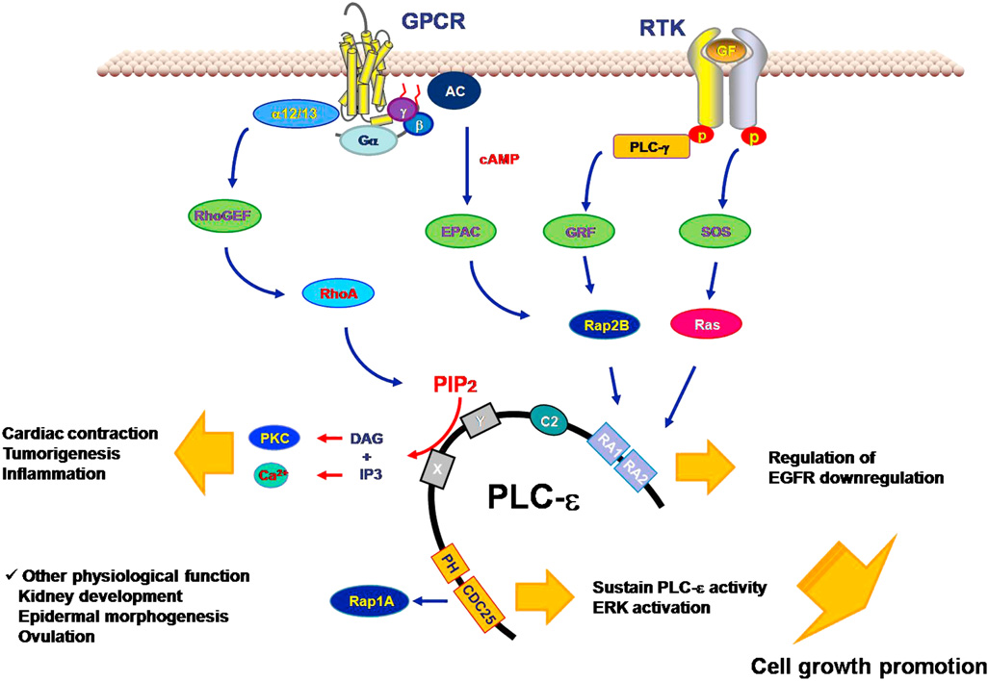
PLC-epsilon Pathway
Figure 5: PLC-epsilon Pathway
Source: https://www.semanticscholar.org/paper/Protein-kinase-C-alpha-negatively-regulates-through-Yun-Byun/2ecc4511bba50593354e01d853dd5d1731ee1f56

Slide 31
PLC-epsilon Explained
PLC-epsilon is a gene that is known to be involved in many different types of cancer. ^{[21]}
When de-regulated, PLC-epsilon is known to cause:
Tumorigenesis^{[20]}
Cardiac contractions^{[20]}
Inflammation, particularly astrocytic inflammation^{[19]}
RAP2B is known to regulate PLC-epsilon expression through direct phosphorylation.^{[23]}
When RAP2B is de-regulated, it is known to promote cell proliferation and cell growth.^{[22]}

Slide 32
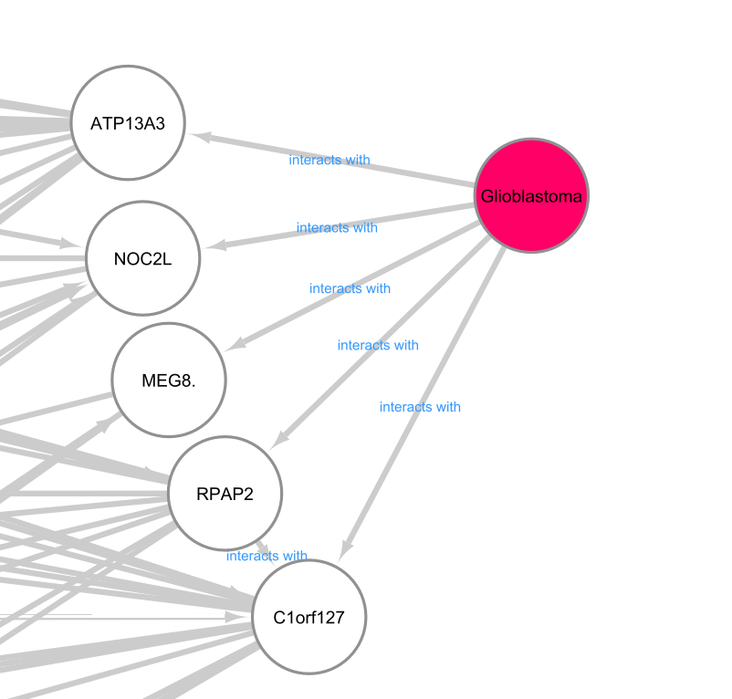
Gene Network

Slide 33
Gene Network cont.
Genes | Association with Glioblastoma
ATP13A3 | Is abnormally expressed in Glioblastoma patients but its role is unclear. (Xiong, J., 2014)
MEG8 | Plays a role in lung and pancreatic cancer. (Terashima, M., 2018)
NOC2L | Theorized to be associated with glioblastoma. (Lab, M., 2005)
C1orf127 | No papers documenting its role in Glioblastoma or cancer.
RPAP2 | No papers documenting its role in Glioblastoma or cancer.

Slide 34
Summary
Using a pathway-based approach, models were created that performed overall better than ones created from the genes alone.
Created a Bayesian Network that was non-inferior to other models in classifying glioblastoma.
Using a Bayesian Network, an in-depth exploration of pathways and associated genes were explored for biological relevance.
The pathway approached made biologically relevant connections.
The gene-based approach made biologically relevant and biologically irrelevant gene connections.

Slide 35
Future Directions
Apply the process to more data.
Apply the process to different cancer types and compare.
Give a specific biological structure to the network.
Explore dysfunction in certain pathways and see the effect on survival outcome.

Slide 36
Acknowledgements
Dr. Gabriel Odom
Involved in the creation of PathwayPCA package and is the active maintainer.
Helped a lot with teaching me how to work with Microarray Data.
Dr. Nan Hu
Helped with teaching how to model biological pathways.
Taught me how to determine if a biological pathway is relevant to a certain disease type.
Subject Matter Expert who has been working Glioblastoma for years.

Slide 37

Questions?

Slide 38
References
Learn. (n.d.). Retrieved November 23, 2020, from https://braintumor.org/take-action/about-gbm/
Watson, S. (2028, September 23). Glioblastoma: Survival Rates, Treatments, and Causes. Retrieved from https://www.healthline.com/health/brain-tumor/glioblastoma
Glioma. (2020, April 04). Retrieved November 23, 2020, from https://www.mayoclinic.org/diseases- conditions/glioma/symptoms-causes/syc-20350251
Hofland, P., By, -, Hofland, P., -, E., & -, L. (2019, June 20). Improving 5-year Survival in Glioblastoma Requires more Aggressive Treatments. Retrieved November 23, 2020, from https://www.oncozine.com/improving-5-year-survival-in-glioblastoma-requires-more-aggressive-treatments/
Bi, W., & Beroukhim, R. (2014, September). Beating the odds: Extreme long-term survival with glioblastoma. Retrieved November 23, 2020, from https://www.ncbi.nlm.nih.gov/pmc/articles/PMC4136904/
Radiation Therapy for Brain Cancer and Spinal Cord Tumors. (n.d.). Retrieved November 23, 2020, from https://www.cancer.org/cancer/brain-spinal-cord-tumors-adults/treating/radiation-therapy.html

Slide 39
References
Chemotherapy. (2020, March 05). Retrieved November 23, 2020, from https://www.mayoclinic.org/tests-procedures/chemotherapy/about/pac-20385033
Glioma. (2020, April 04). Retrieved November 23, 2020, from https://www.mayoclinic.org/diseases-conditions/glioma/diagnosis-treatment/drc-20350255
Gusev, Y., Bhuvaneshwar, K., Song, L., Zenklusen, J., Fine, H., & Madhavan, S. (2018, August 14). The REMBRANDT study, a large collection of genomic data from brain cancer patients. Retrieved November 23, 2020, from https://www.ncbi.nlm.nih.gov/pmc/articles/PMC6091243/
Biological Pathways Fact Sheet. (n.d.). Retrieved November 23, 2020, from https://www.genome.gov/about-genomics/fact-sheets/Biological-Pathways-Fact-Sheet
Odom, G., Ban, Y., Colaprico, A., Liu, L., Silva, T., Sun, X., . . . Chen, X. (2020, July 02). PathwayPCA: An R/Bioconductor Package for Pathway Based Integrative Analysis of Multi‐Omics Data. Retrieved July 22, 2020, from https://onlinelibrary.wiley.com/doi/abs/10.1002/pmic.201900409
D. (2019, July 16). Introduction to Bayesian Networks. Retrieved November 23, 2020, from https://towardsdatascience.com/introduction-to-bayesian-networks-81031eeed94e

Slide 40
References
Marco Scutari (2010). Learning Bayesian Networks with the bnlearn R Package. Journal of Statistical Software, 35(3), 1-22. URL http://www.jstatsoft.org/v35/i03/
Shannon P, Markiel A, Ozier O, et al. Cytoscape: a software environment for integrated models of biomolecular interaction networks. Genome Res. 2003;13(11):2498-2504. doi:10.1101/gr.1239303
Niu, B., Liang, C., Lu, Y., Zhao, M., Chen, Q., Zhang, Y., . . . Chou, K. (2019, May 29). Glioma stages prediction based on machine learning algorithm combined with protein-protein interaction networks. Retrieved November 23, 2020, from https://www.sciencedirect.com/science/article/pii/S0888754319301740
Ryskalin, L., Busceti, C. L., Biagioni, F., Limanaqi, F., Familiari, P., Frati, A., & Fornai, F. (2019). Prion Protein in Glioblastoma Multiforme. International journal of molecular sciences, 20(20), 5107. https://doi.org/10.3390/ijms20205107
Fulda, S. Cell death-based treatment of glioblastoma. Cell Death Dis 9, 121 (2018). https://doi.org/10.1038/s41419-017-0021-8
Krishna, K., Dubey, S., Singhvi, G., Gupta, G., & Kesharwani, P. (2020, September 10). MAPK pathway: Potential role in glioblastoma multiforme. Retrieved October 28, 2020, from https://www.sciencedirect.com/science/article/pii/S221475192030462X

Slide 41
References
Dusaban, S., Purcell, N., Rockenstein, E., Masliah, E., Cho, M., Smrcka, A., & Brown, J. (2013, February 26). Phospholipase Cɛ links G protein-coupled receptor activation to inflammatory astrocytic responses. Retrieved November 23, 2020, from https://www.pnas.org/content/110/9/3609
Yun S; Byun HY; Oh YS; Yang YR; Ryu SH; Suh PG;. (n.d.). Protein kinase C-alpha negatively regulates EGF-induced PLC-epsilon activity through direct phosphorylation. Retrieved November 23, 2020, from https://pubmed.ncbi.nlm.nih.gov/19948183/
Tyutyunnykova, A., Dubrovska, A., & Telegeev, G. (2017). The controversial role of phospholipase C epsilon (PLCε) in cancer development and progression. Retrieved November 23, 2020, from https://www.jcancer.org/v08p0716.htm
Miao F; Cui C; Zuo D; Zhang H; Mei P; Chen H; Wei S; Yang F; Zheng J; Bai J; Fan Y;. (2019). Rap2B promotes cell adhesion, proliferation, migration and invasion of human glioma. Retrieved November 23, 2020, from https://pubmed.ncbi.nlm.nih.gov/30997639/
Qu, D., Huang, H., Di, J., Gao, K., Lu, Z., & Zheng, J. (2016, April 01). Structure, functional regulation and signaling properties of Rap2B (Review). Retrieved November 23, 2020, from https://www.spandidos-publications.com/10.3892/ol.2016.4261

Slide 42
References
Xiong, J., Bing, Z., Su, Y., Deng, D., & Peng, X. (2014, May 28). An integrated mRNA and microRNA expression signature for glioblastoma multiforme prognosis. Retrieved November 23, 2020, from https://www.ncbi.nlm.nih.gov/pmc/articles/PMC4037214/
Terashima, M., Ishimura, A., Wanna-Udom, S., & Suzuki, T. (2018, November 23). MEG8 long noncoding RNA contributes to epigenetic progression of the epithelial-mesenchymal transition of lung and pancreatic cancer cells. Retrieved November 23, 2020, from https://www.ncbi.nlm.nih.gov/pmc/articles/PMC6254362/
Lab, M. (2005). Interaction Summary. Retrieved November 23, 2020, from https://thebiogrid.org/interaction/720110
Agrahari, R., Foroushani, A., Docking, T. R., Chang, L., Duns, G., Hudoba, M., … Zare, H. (2018, May 3). Applications of Bayesian network models in predicting types of hematological malignancies. Retrieved from https://www.nature.com/articles/s41598-018-24758-5
Blood Test Can Predict Prognosis in Deadly Brain Cancer – PR News. (n.d.). Retrieved November 24, 2020, from https://www.pennmedicine.org/news/news-releases/2019/october/blood-test-can-predict-prognosis-in-deadly-brain-cancer

Slide 43
References
Braschi B, Denny P, Gray K, Jones T, Seal R, Tweedie S, Yates B, Bruford E. Genenames.org: the HGNC and VGNC resources in 2019. Nucleic Acids Res. 2019 Jan 8;47(D1):D786-D792. PMID:30304474
Subramanian, A., Tamayo, P., Mootha, V., Mukherjee, S., Ebert, B., Gillette, M., . . . Mesirov, J. (2005, October 25). Gene set enrichment analysis: A knowledge-based approach for interpreting genome-wide expression profiles. Retrieved November 25, 2020, from https://www.pnas.org/content/102/43/15545.abstract

